Slide 1
UML

Slide 2
Data Flow Diagram (DFD)
Data Flow Diagram (DFD) provides a visual representation of the flow of information (i.e. data) within a system.
By drawing a Data Flow Diagram, you can tell the information provided by and delivered to someone who takes part in system processes, the information needed to complete the processes and the information needed to be stored and accessed.

Slide 3
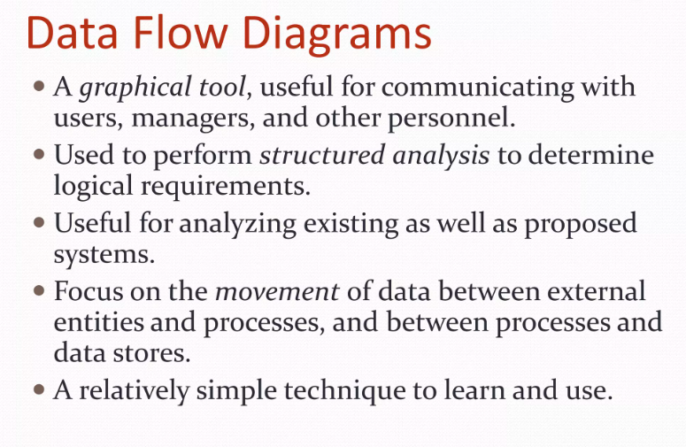

Slide 4
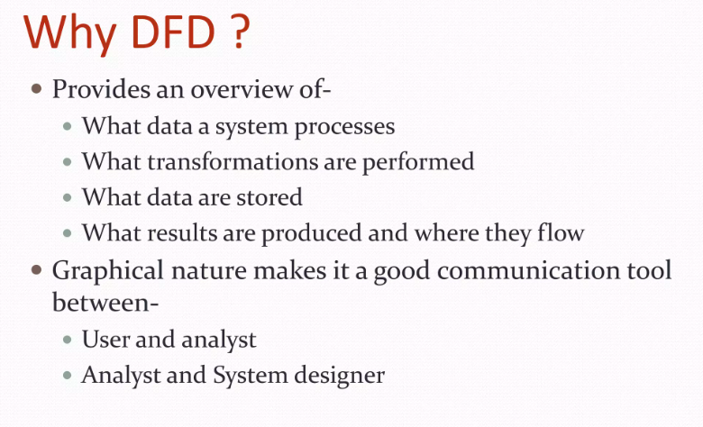

Slide 5
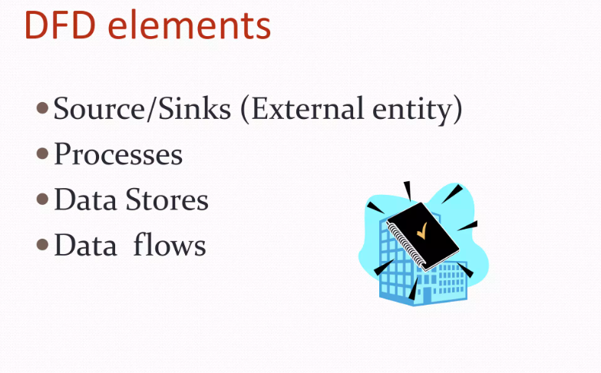

Slide 6
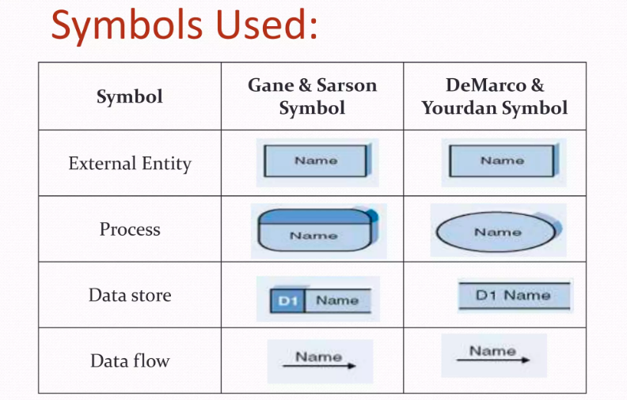

Slide 7
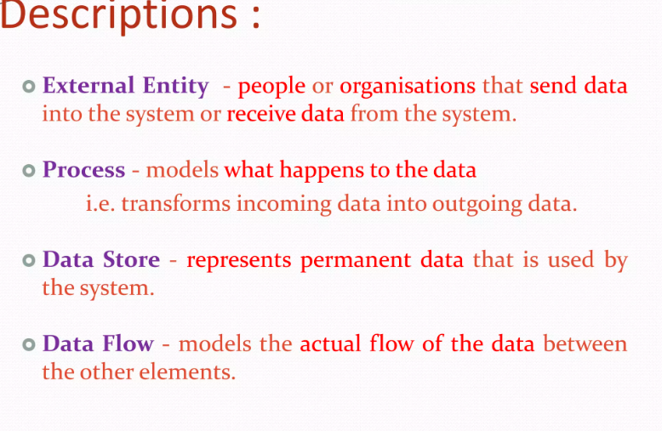

Slide 8
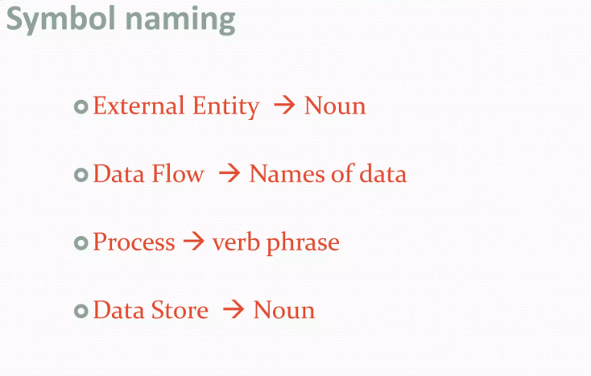

Slide 9
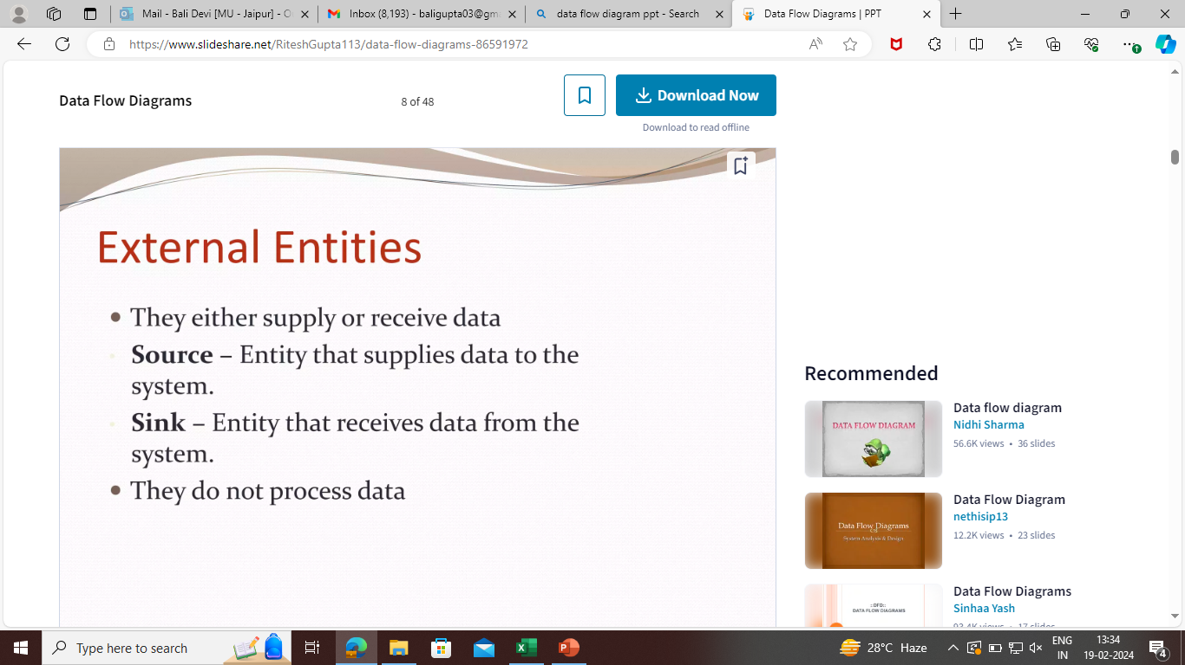

Slide 10
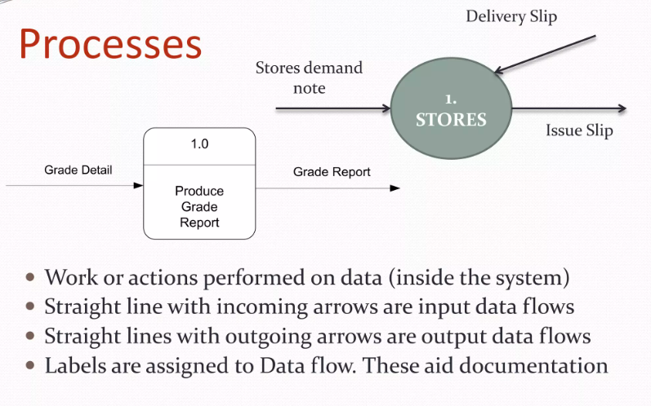

Slide 11
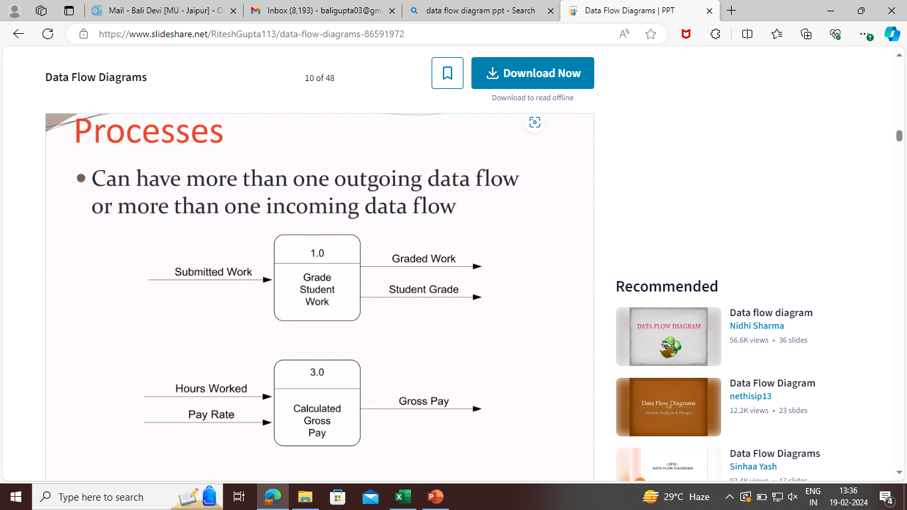

Slide 12
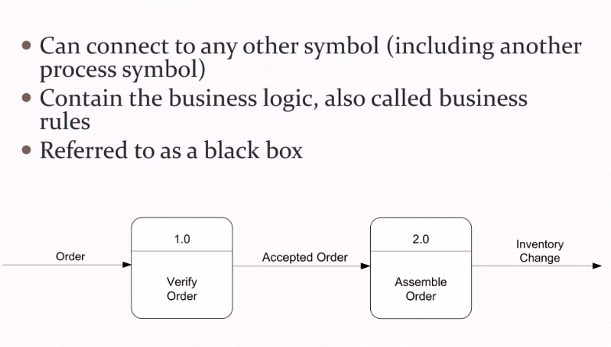

Slide 13
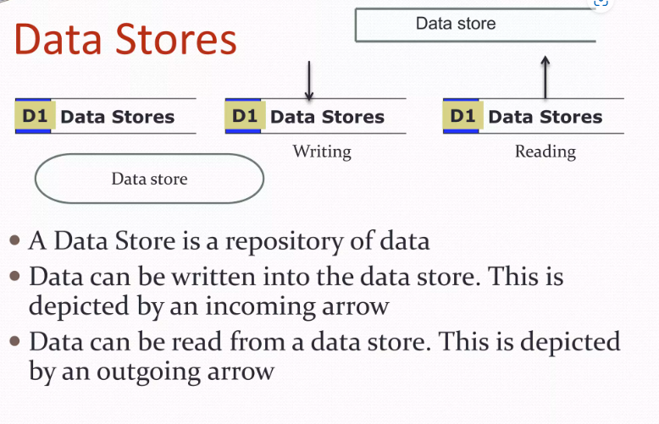

Slide 14
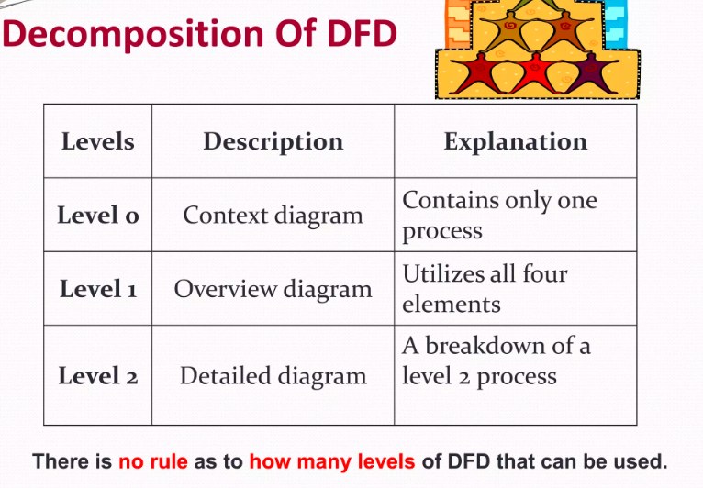

Slide 15
The Food Ordering System Example
Context DFD
A context diagram is a data flow diagram that only shows the top level, otherwise known as Level 0. At this level, there is only one visible process node that represents the functions of a complete system in regards to how it interacts with external entities. Some of the benefits of a Context Diagram are:
1. Shows the overview of the boundaries of a system
2. No technical knowledge is required to understand with the simple notation
3. Simple to draw, amend and elaborate as its limited notation

Slide 16
The figure below shows a context Data Flow Diagram that is drawn for a Food Ordering System. It contains a process (shape) that represents the system to model, in this case, the "Food Ordering System". It also shows the participants who will interact with the system, called the external entities. In this example, the Supplier, Kitchen, Manager, and Customer are the entities who will interact with the system. In between the process and the external entities, there is data flow (connectors) that indicate the existence of information exchange between the entities and the system.

Slide 17
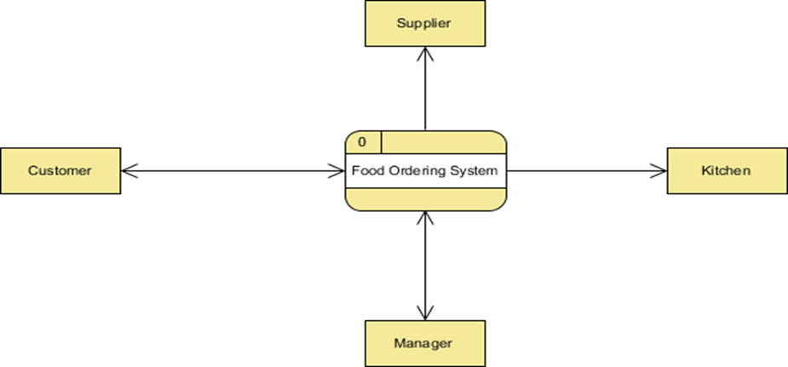

Slide 18
Level 1 DFD
The figure below shows the level 1 DFD, which is the decomposition (i.e. break down) of the Food Ordering System process shown in the context DFD. Read through the diagram and then we will introduce some of the key concepts based on this diagram.
The Food Order System Data Flow Diagram example contains three processes, four external entities, and two data stores.
Based on the diagram, we know that a Customer can place an Order. The Order Food process receives the Order, forwards it to the Kitchen, store it in the Order data store, and store the updated Inventory details in the Inventory data store. The process also delivers a Bill to the Customer.

Slide 19
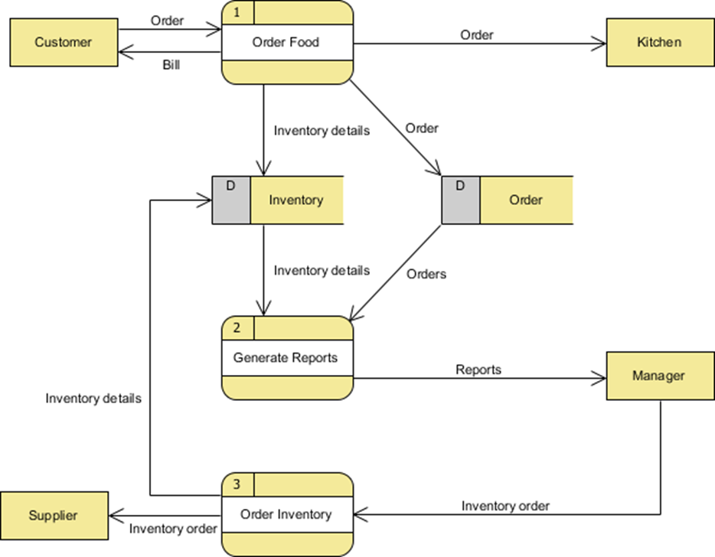

Slide 20
The Manager can receive Reports through the Generate Reports process, which takes Inventory details and Orders as input from the Inventory and Order data store respectively.
The Manager can also initiate the Order Inventory process by providing Inventory order. The process forwards the Inventory order to the Supplier and stores the updated Inventory details in the Inventory data store.

